Slide 1

EIE 2001 Basic Circuit Theory
Lecture 5 First-order Circuits
Part I. Capacitors and Inductors
(steady state analysis with DC)

Slide 2
Overview
Introduce two linear circuit elements, unlike resistors, these elements do not dissipate energy, they instead store and release energy
  Capacitor
  Inductor
  Series-Parallel combinations
  Current-Voltage relationship, energy storage
Response of RL and RC circuits
  First-order system
  Natural and transient responses

Slide 3
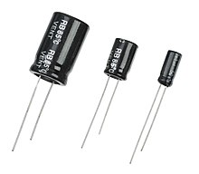
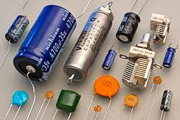
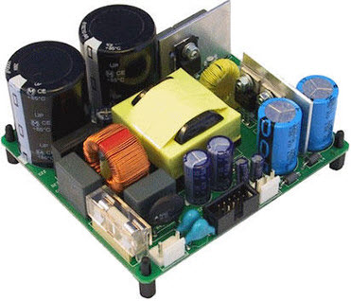
Capacitors
A capacitor is a passive element designed to store energy in its electric field.
Capacitors are used extensively in electronics, communications, computers and power systems.
A capacitor is typically constructed as the figure on the right: it consists of two conducting plates separated by an insulator (or dielectric)
  The plates are typically aluminum foil
  The dielectric is often air, ceramic, paper, plastic, or mica
Notes:
Mica：云母

Slide 4
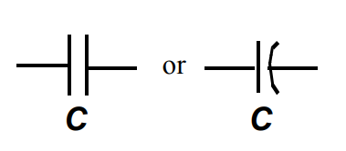
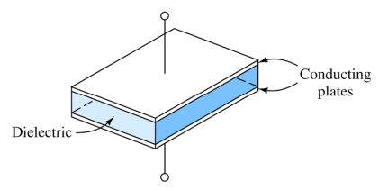
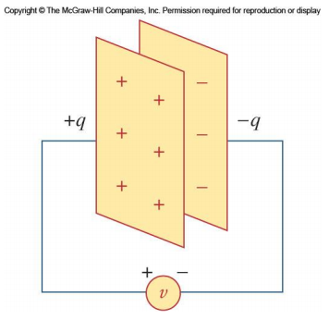


Capacitors
Circuit Symbol
When a voltage source v is connected to the capacitor, the source deposits a positive charge q on one plate and a negative charge –q on the other.
The amount of charge is proportional to the voltage:
where C is the capacitance
or

Slide 5
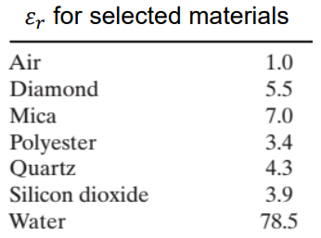
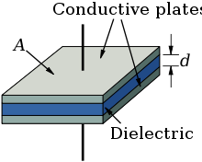


Capacitors
The unit of capacitance is the Farad (F), One Farad is 1 Coulomb/Volt
Most capacitors are rated in picofarad (pF) and microfarad (μF)
The capacitance is determined by
  Proportional to the area of the plates (A)
  Inversely proportional to the space between them (d)
  ε is the permittivity of the dielectric
permittivity is the measure of a material's ability to resist an electric field, not its ability to “permit” it, as the name it might seem to suggest.
$${ε=ε_{0}ε}_{r}$$
Relative permittivity
Vacuum permittivity
$ε_{0}=8.85×{10}^{−12}$F/m

Slide 6
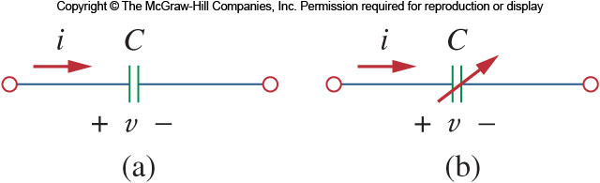
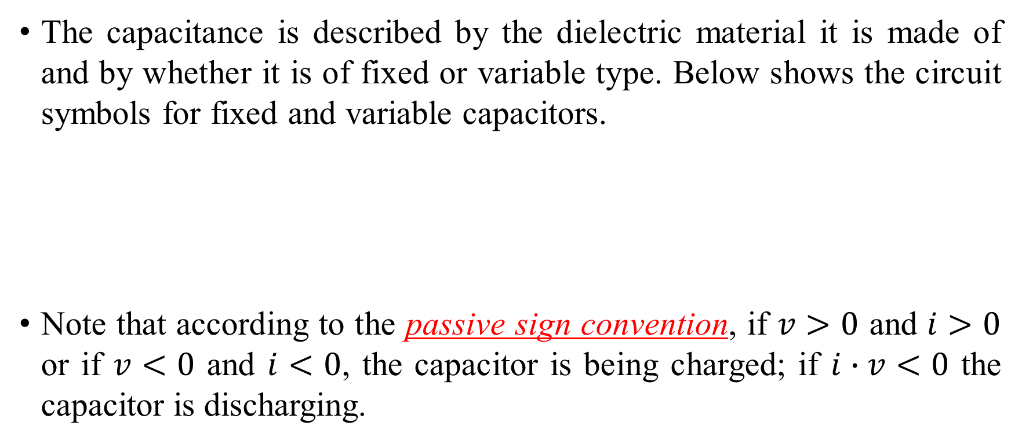
Capacitors
The capacitance is described by the dielectric material it is made of and by whether it is of fixed or variable type. Below shows the circuit symbols for fixed and variable capacitors.
Note that according to the passive sign convention, if $v>0$ and $i>0$ or if $v<0$ and $i<0$, the capacitor is being charged; if $i∙v<0$ the capacitor is discharging.

Slide 7
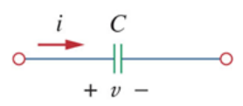
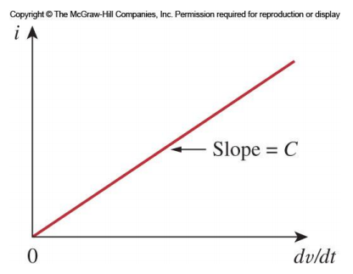
Current-Voltage Relationship
Using the formula for the charge stored in a capacitor, we can find the current-voltage relationship
Recall that q = C v
Take the first derivative with respect to time gives:
Pay attention to the polarity and the current direction!
Similarly, the voltage current relationship is:
The voltage at time t depends on the initial voltage at t_{0,} This shows that the capacitor has a memory.
This assumes the passive sign convention
Notes:
If the capacitor is charged from an uncharged state: v(t₀)=0

Slide 8
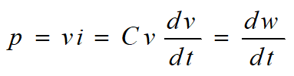
Power and Stored Energy
The instantaneous power delivered to the capacitor is
Therefore, the energy stored in a capacitor is:

Slide 9
Properties of Capacitors
Ideal capacitors all have these characteristics:
At the steady state, a capacitor is an open circuit.
  When the voltage is not changing, the current through the capacitor is zero. This means that with DC applied, eventually no current will flow
The voltage on a capacitor cannot change abruptly. Voltage across a capacitor must be continuous.
  An abrupt change in voltage would require an infinite current!
  If the voltage on the capacitor does not equal the applied voltage, charge will flow and the voltage will finally reach the applied voltage (transient current charging).
  Conversely, the current through a capacitor can change instantaneously.

Slide 10
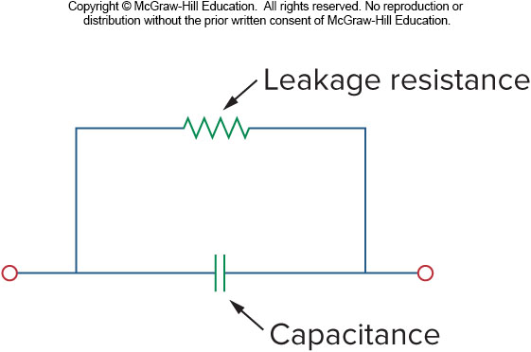
Ideal Capacitors versus Real Capacitors
An ideal capacitor does not dissipate energy, meaning stored energy may be retrieved later without loss
A real capacitor has a parallel-model leakage resistance, leading to a slow loss of the stored energy internally
  This resistance is typically very high, on the order of 100 MΩ and thus can be ignored for many circuit applications.
More realistic model of a capacitor
A more realistic model of a capacitor

Slide 11
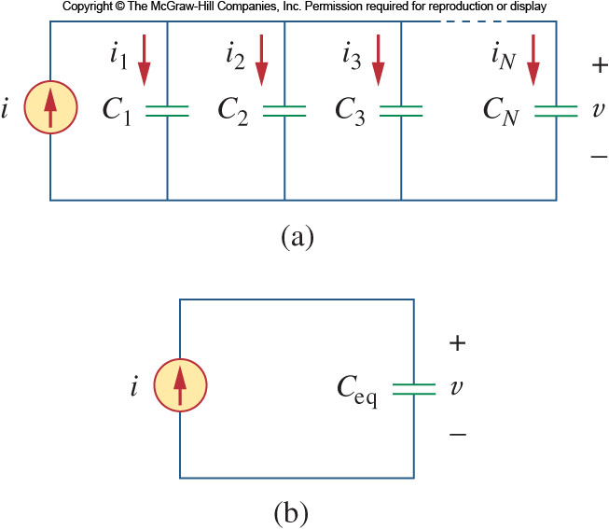
Parallel Capacitors
The voltages on all the capacitors are the same
Applying KCL:
Taking into consideration the current voltage relationship of each capacitor:
The equivalent capacitance of N parallel-connected capacitors is the sum of the individual capacitances

Slide 12
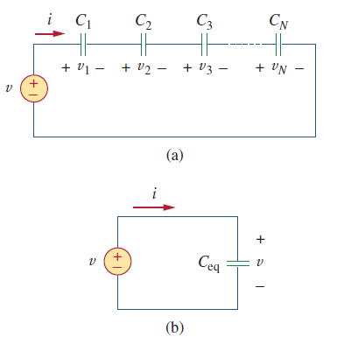
Series Capacitors
Each capacitor shares the same current
Applying KVL to the loop:
Apply the voltage current relationship,
The equivalent capacitance of series-connected capacitors is the reciprocal of the sum of the reciprocals of the individual capacitance

Slide 13
Series and Parallel Capacitors
Another way to think about the combinations of capacitors is this:
Combining capacitors in parallel is equivalent to increasing the surface area of the capacitors (A)
  This would lead to an increased overall capacitance (as is observed)
A series combination can be seen as increasing the total plate separation (d)
  This would result in a decrease in capacitance (as is observed)

Slide 14
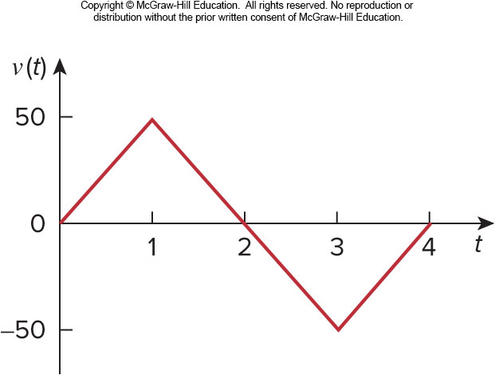
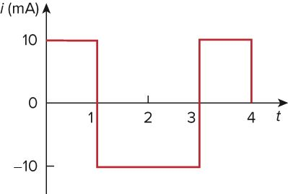

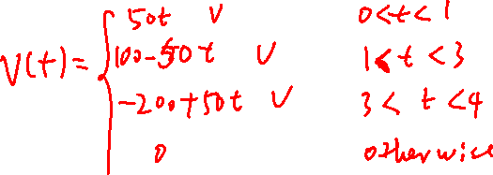
Example 1
Determine the current through a 200-μF capacitor whose voltage is shown
First, the voltage waveform can be described mathematically as
Since i = C $\frac{dv}{dt}$ and C = 200 μF, we take the derivative of v
to obtain

Slide 15
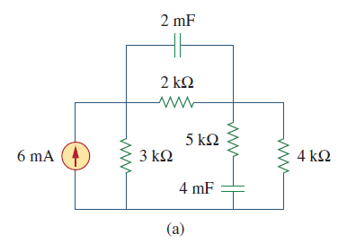
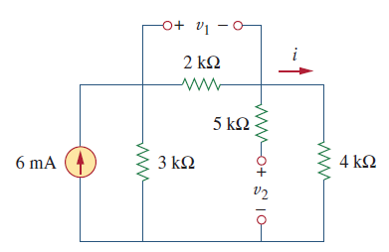
Example 2
Obtain the energy stored in each capacitor in the circuit。
Answer: Under DC condition, both capacitors will be open circuit upon fully charged.
Find the current i as indicated:
Solve for v₁ and v₂:
Solve for energy stored w₁ and w₂:
Notes:
(6 – i) * 3 = i * (2 + 4), → i = 2 mA
v1 = 2 * 2 = 4 V, v2 = 2 * 4 = 8 V
W1 = ½ * 2mF * 4^2 = 0.016 Joul
W2 = ½ * 4mF * 8^2 = 0.128 Joul

Slide 16
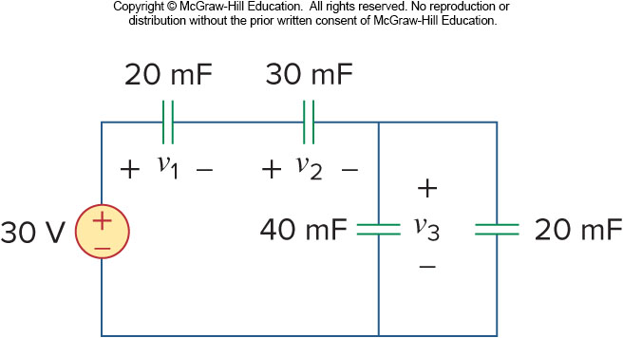
Example 3
Find the voltage in Volts across each capacitor.
Answer:
Find the equivalent capacitance in the circuit.
Calculate the total charge in the loop.
Based on the total charge to solve for v₁ and v₂.
Apply KVL to find v₃.
Hint: Capacitors in series sharing the same current upon charging, the charge in each element in series will be the same.
Notes:
Solution: Equivalent circuit: 30V – 20 mF – 30mF -- 60 mF in series, then 30V – 10 mF in series. Total charge Q = Ceq V = 10mF * 30V = 300 m Coloumb
V1 = Q/C1 = 300 mC / 20 mF = 15V, V2 = 300 mC / 30 mF = 10 V, V3 = 300 mC / 60 mF = 5 V.

Slide 17
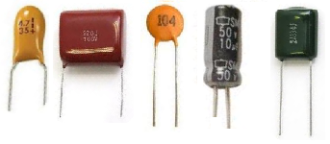
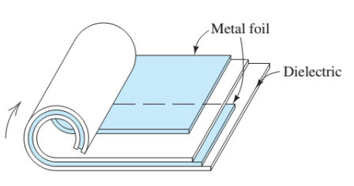
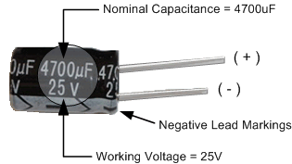
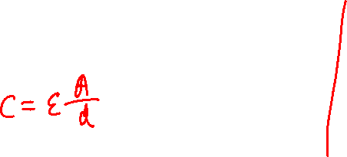
Applications for Capacitors
Capacitors have a wide range of applications, some of which are:
  Energy Storage
  Signal Processing
    Passing AC signals
    Blocking DC signals
    Filters and shift phase
    Suppress noise
  Sensing

Slide 18
Application – capacitive touch screen

Slide 19
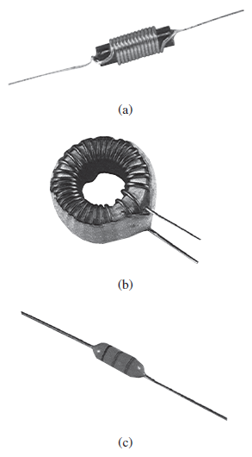

Inductors
An inductor is a passive element that stores energy in its magnetic field
They have applications in power supplies, transformers, radios, TVs, radars, and electric motors.
Any conductor has inductive properties and may be regarded as an inductor, but the effect is typically enhanced by coiling the wire up.
Circuit Symbol

Slide 20
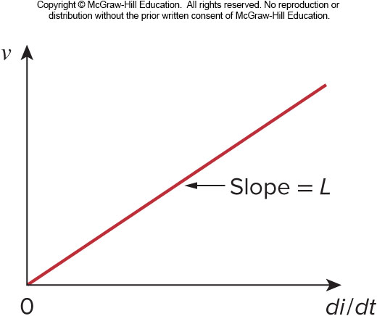
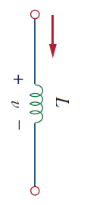
Voltage-Current Relationship
If a current passes through an inductor, the voltage across it is directly proportional to the time rate of change in current. Using the passive sign convention, it is written as
where, L is inductance, measured in henry (H), 1 henry equals 1 volt-second per ampere.
i
Inductance is the property whereby an inductor exhibits opposition to the change of current flowing through it.

Slide 21
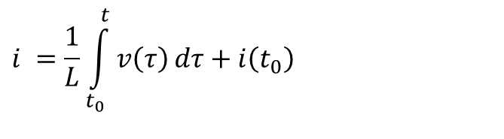
Power and Stored Energy
Therefore, the current voltage relationship for an inductor is:
The power delivered to the inductor is:
The energy stored in the inductor is:
$$i =\frac{1}{L}\int_{t_{0}}^{t}{v\left(τ\right)}dτ+i\left(t_{0}\right)$$
Notes:
Regarding the last equation, taking derivative over t will lead to the 2nd last equation.

Slide 22
Properties of Inductors
Ideal inductors all have these characteristics:
An inductor acts like a short circuit to DC
  If the current through an inductor is constant, the voltage across it is zero
The current through an inductor cannot change instantaneously. Current through an inductor must be continuous.
  If this did happen, the voltage across the inductor would be infinity!
  This is an important consideration if an inductor is to be turned off abruptly; it will produce a high voltage (Tesla tube for generating sparks).
  Conversely, the voltage across an inductor can change abruptly.

Slide 23
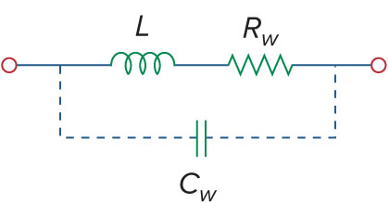
Properties of Inductors
An ideal inductor does not dissipate energy stored in it, energy stored will be returned to the circuit later without loss
In reality, inductors do have resistive component due to the wiring used to make them. A real inductor thus has a winding resistance in series with it; There is also a small winding capacitance due to the closeness of the windings
  These two characteristics are typically small, though at high frequencies, the capacitance may matter.
More realistic model of an inductor

Slide 24
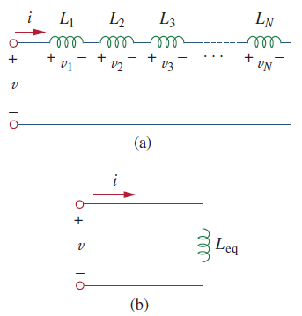
Series Inductors
First, let’s consider a series combination of inductors. Note the same current.
Applying KVL to the loop:
Using in the voltage current relationship
The equivalent inductance of series-connected inductors is the sum of the individual inductances.

Slide 25
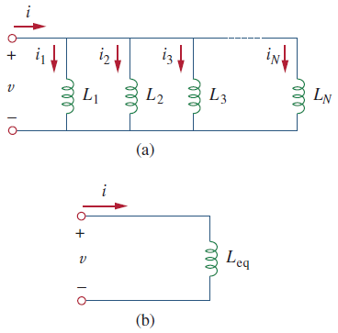
Parallel Inductors
A parallel combination of inductors have the same voltage
Applying KCL to the circuit:
Applying current voltage relationship :
The equivalent inductance of parallel inductors is the reciprocal of the sum of the reciprocals of the individual inductances.

Slide 26
Example 4
Find the equivalent inductance of the circuit
Answer: 18H and 25mH

Slide 27
Example 5
Determine i, v_{C} and i_{L}, and the energy stored in the capacitor and inductor in the circuit in steady state.
Remark: In the steady state, there is no voltage drop across the inductor and no current through the capacitor.
Notes:
Solutino: i = i_L = 12V / 6 Om = 2 A
V_C = i * 5 Ohm = 2 * 5 = 10V
w_L = ½ * L * i_L ^2 = ½ * 2 * 2^2 = 4 J
W_C = ½ * C * v_C ^2 = ½ * 1 * 10^2 = 50 J

Slide 28
Applications for Inductors
Due to their bulky size, inductors are less frequently used as compared to capacitors, however they have some applications where they are best suited.
They can be used to create a large amount of current or voltage for a short period of time.
Their resistance to sudden changes in current can be used for spark suppression.
Along with capacitors, they can be used for frequency discrimination.

Slide 29
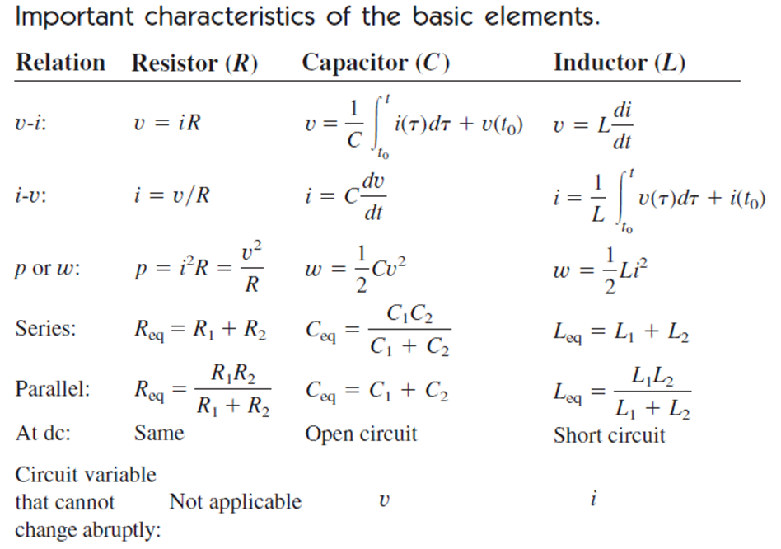
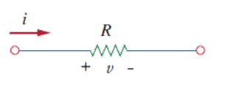
Summary
Passive sign convention is assumed
i

Slide 30


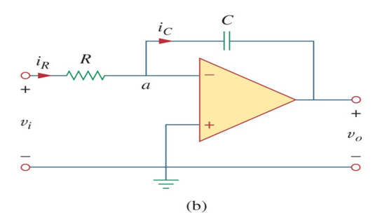
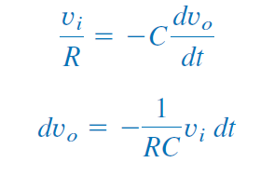
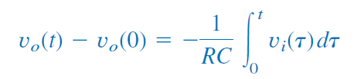
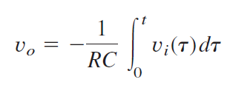
Application Example – Integrator
Capacitors, in combination with op-amps can be made to perform advanced mathematical functions
One such function is the integrator: by replacing the feedback resistor with a capacitor, the output voltage from the op-amp is:
Assuming v_{o}(0)=0, then

Slide 31
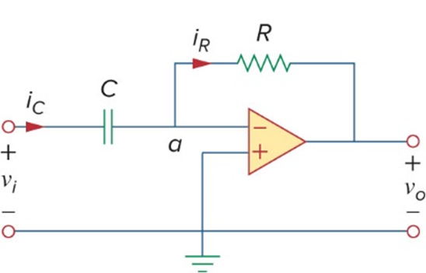
Application Example – Differentiator
The previous circuit functions as an integrator with time. If the capacitor is used in place of the input resistor instead of the feedback resistor, there will only be current flowing if the voltage is changing
The output voltage in this case will be:
From this it is clear this circuit performs differentiation with time
Remark: differentiator circuit not effective in the presence of noise; it is electronically unstable because any electrical noise within the circuit is exaggerated by the differentiator. For this reason, the differentiator circuit in figure above is not as useful and popular as the integrator. It is seldom used in practice.

Slide 32
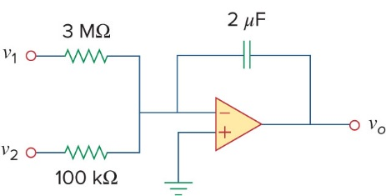
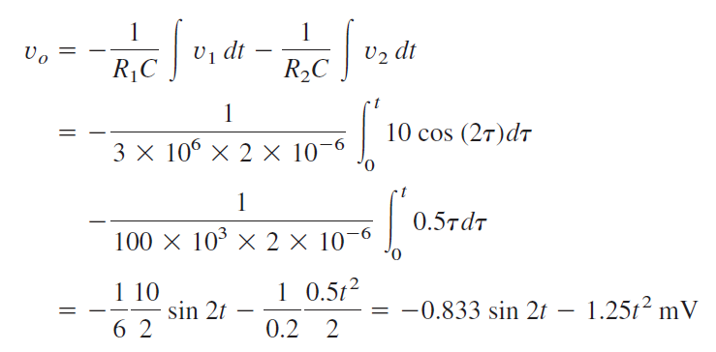
Examples
Given the input v₁ = 10 cos 2t mV and v₂ = 0.5t mV
C=2 μF, R₁=3 MΩ, R₂=100 kΩ
By the principle of superposition
Assuming at t=0, output voltage is zero.

Slide 33
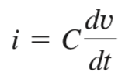

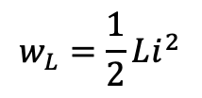

Expected learning outcome
Understand and be familiar with the i-v relationships of a capacitor and an inductor:
Be able to compute equivalent capacitance and inductance for parallel and in-series capacitors and inductors, respectively
Be able to analyze a circuit in its steady state with resistors, capacitors, and inductors when the inputs are DC sources; be able to compute the stored energy in capacitors and inductors in their steady states.
$$w_{C}=\frac{1}{2}Cv^{2}$$
$$w_{L}=\frac{1}{2}Li^{2}$$

Slide 34
EIE 2001 Basic Circuit Theory
Lecture 5
Part II. First-order RL and RC Circuits
(transient state analysis)

Slide 35
Overview
Introduce two linear circuit elements, unlike resistors, these elements do not dissipate energy, they instead store energy
  Capacitor
  Inductor
  Series-Parallel combinations
  Current-Voltage relationship, energy storage
Response of RL and RC circuits
  First-order system
  Natural and transient responses

Slide 36
First Order Circuits
An important attribute of capacitors and inductors is their ability to store energy.
RL and RC circuits are also known as first-order circuits, because their voltages and currents are described by first order differential equations.
Note that only one energy storage element is present in the first-order circuits, either capacitor or inductor.

Slide 37
Something about C and L
For C: and for L:
By exchanging variables , the equations change into each other.
Results obtained for capacitors may readily be extended to inductors , and vice versa.

Slide 38
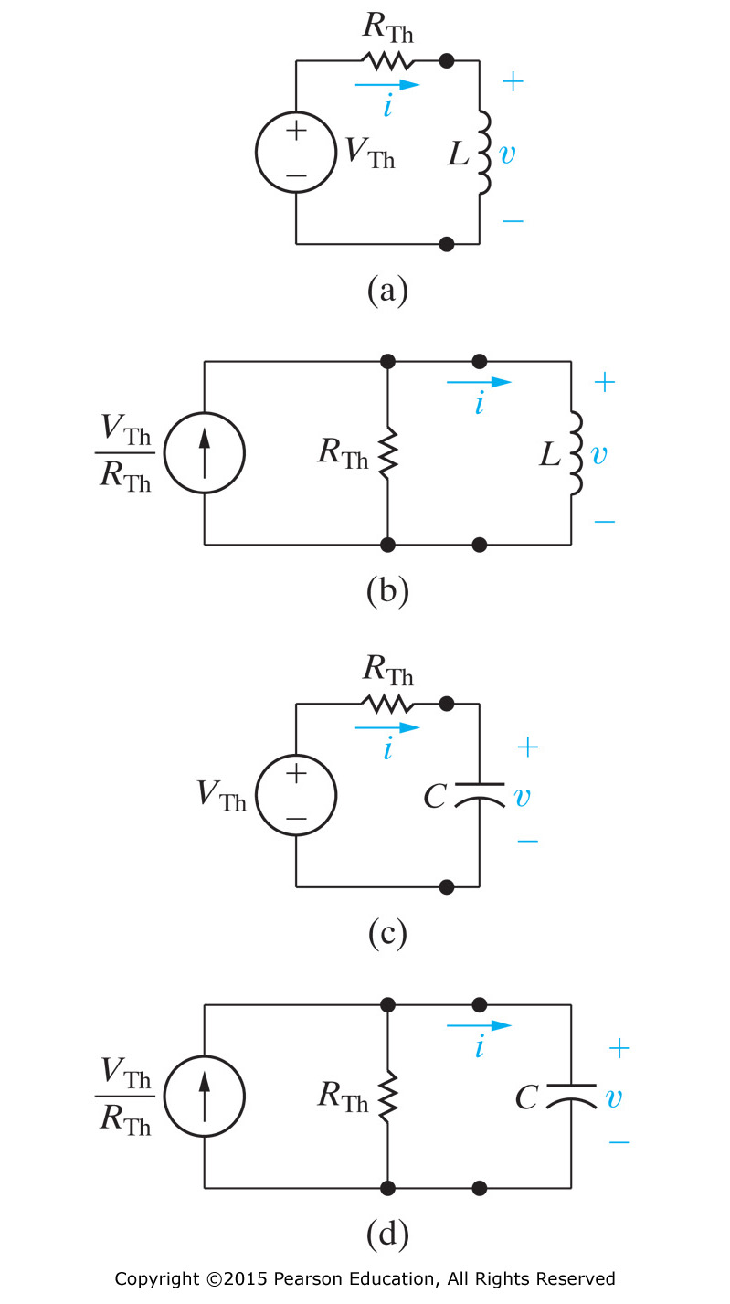
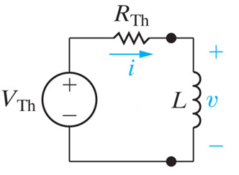
Thévenin and Norton equivalent can be used to obtain the following four possible first order circuits

Slide 39
Response of a Circuit
Previously we focused on the steady-state response under DC condition
  Capacitor is taken as open circuit
  Inductor is taken as short circuit
In the following we will talk about the following
Natural response
  Source free, no independent sources; energy stored in the element is released to the resistive part of the circuit.
Step (including Transient and Steady-State) response:
  Behavior when voltage/current source is suddenly applied to or removed from the circuit due to switching, before steady-state is reached.

Slide 40
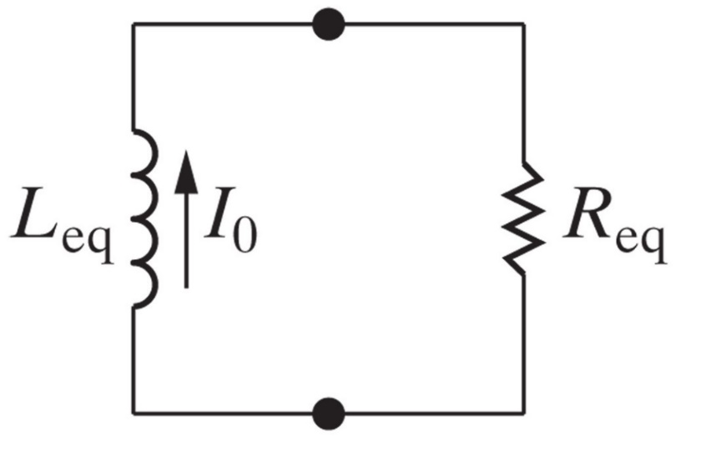

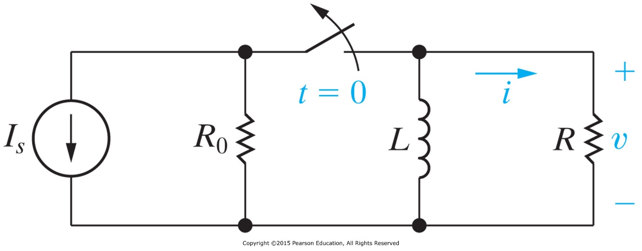

Natural Response - Discharge
RL Circuit
RC Circuit

Slide 41
Review: Solving
Separate variables
Integrating both side from time 0 to time t
which yields
Exponentiate both side

Slide 42
Review: Solving
Separate variables
Integrating both side from time 0 to time t
which yields
Exponentiate both sides

Slide 43

Source Free RC Circuit
Consider a series combination of a resistor and an initially charged capacitor.
Can take it this way: the source free RC circuit occurs when its dc source is suddenly disconnected.
The energy stored in the capacitor is released to the resistors.
Let the initial voltages at t=0 to be
Apply KCL at the top node:
Obtain the equation

Slide 44

Natural Response of RC Circuit
The result shows that the voltage response of the RC circuit is an exponential decay of the initial voltage.
The speed at which the voltage decays can be
characterized by a time constant
In 1τ’s time, the voltage to drop to $\frac{1}{e}=\frac{1}{2.718}=0.368$ of the initial voltage.

Slide 45


Time Constant τ
After 5 τ, the voltage on the capacitor is less than 1%.
A capacitor is considered to be either fully discharged
A circuit with a small τ has a fast response and vice versa.

Slide 46





RC Discharge
With the voltage known, we can find the current:
The power dissipated in the resistor is:
The energy absorbed by the resistor is:
Tangent at t=0

Slide 47

Source Free RL Circuit
Now let’s consider the series connection of a resistor and an inductor.
Since the current cannot change instantaneously, we can determine its value as a function of time.
Once again, start with an initial current passing through the inductor.
Initial current:
Apply KVL in the loop
Obtain the ODE & solution:
Characteristic time constant in this case:
$$v_{L}+v_{R}=0$$

Slide 48





RL Discharge
With the current known, we can find the voltage across the resistor:
The power dissipated in the resistor is:
The energy absorbed by the resistor is:

Slide 49


Example 6
The switch in the circuit has been closed for a long time, and it is opened at t = 0. Find v(t) for t ≥ 0.
t <0
t >0

Slide 50


Example 7
The switch in the circuit has been closed for a long time, and it is opened at t = 0. Find i(t) for t ≥ 0.

Slide 51
Response with External Source
Now we are ready to discuss the problem of finding the currents and voltages generated in first-order RL or RC circuits when either DC voltage or current sources are suddenly applied.
It is the response of the circuit to an external power source, transient before it is settle down into steady state response.
But before that, let’s cover some important mathematical functions.

Slide 52
Singularity Functions
Singularity functions are functions that either are discontinuous or have discontinuous derivatives.
Certain singularity functions serve as good approximations to switching on or off a signal.
The three most common singularity functions are the
  Unit step,
  Unit impulse,
  Unit ramp.

Slide 53


The Unit Step
A step function is one that maintains a constant value before a certain time and then changes to another constant afterwards.
The prototypical form is zero before t=0 and one afterwards.
The unit step function is written as u(t).
Mathematically, the unit step is expressed as:
The switching time may be shifted to t=t₀ by:
Note that this results in a delay in the switch.
Remark: derivative of u(t)at t=t₀ is not well defined.

Slide 54


Equivalent Circuit
The unit step function has an equivalent circuit to represent when it is used to switch on a source.
The equivalent circuits for a voltage and current source are shown.
Using the step function removes the need of showing switches in the circuit diagram (an equivalent but more compact representation)

Slide 55


The Unit Impulse Function
The derivative of the unit step function is the unit impulse function (also known as Dirac delta function (a generalized function)).
This is expressed as:
Impulsive currents and voltages occur in electric circuits as a result of switching operations or impulsive sources.
Although the unit impulse function is not physically realizable (just like ideal sources, ideal resistors, etc.), it is a very useful mathematical tool. e.g.
$$δ\left(t\right)=\frac{d}{dt}u\left(t\right)$$
$$\int_{−∞}^{∞}{δ(τ)dτ=1}$$

Slide 56


The Unit Ramp Function
Integration of the unit step function u(t) results in the unit ramp function:
The unit ramp function is zero for negative values of t and has a unit slope for positive values of t.
Much like the other functions, the onset of the ramp may be adjusted. A more general ramp may be defined as:
$r^{′}\left(t\right)=Ar\left(t−t_{0}\right)$, where 𝐴 is a constant.

Slide 57
What is the relationship between these three singularity functions?
$$δ\left(t\right)=\frac{du(t)}{dt}$$
$$u\left(t\right)=\frac{dr(t)}{dt}$$

Slide 58


Step Response of RC Circuit
When a DC source is suddenly applied to a RC circuit, the source can be modeled as a step function.
The circuit response is known as the step response.
For a RC circuit as shown here, we can represent the voltage across the capacitor as a function of time after the switch is closed.

Slide 59


Step Response of RC Circuit
Assume an initial voltage of V₀ on the capacitor. Then we have
For t>0 this becomes:
Recall the solution for this differential equation and apply the initial condition:

Slide 60
Step Response of RC Circuit
This is known as the complete response, or total response.
We can consider the response to be broken into two separate responses:
  The natural response of the capacitor or inductor due to the energy stored in it (initial voltage V₀). This part decays in time.
  The second part is the forced response (by applied V_{s}): this part is growing in time.
The eventual response of the circuit is to reach V_{s} after the natural response decays to zero.

Slide 61

Another Perspective
Another way to look at the response is to break it up into the transient response and the steady state response:
where the transient is:
and the steady state is:
A more compact expression:
$$v\left(t\right)=V_{0}\left[1−u\left(t\right)\right]+V_{s}u\left(t\right)+\left(V_{0}−V_{s}\right)e^{−t/τ}u(t)$$

Slide 62



Step Response of Current
Current
Current decays while voltage rises.
Remark: The analysis of RC step response is very general. It actually applies to any network connected to a capacitor, since the network is always equivalent to a source plus a resistance.
V₀=0

Slide 63

Step Response of RL Circuit
Now we can look at the step response of a RL circuit.
We will use the transient and steady state response approach.
We know that the transient response will be an exponential:
After a sufficiently long time, the current will reach the steady state:
This yields an overall response of:
Current is continuous, at t = 0:

Slide 64




Step Response of RL Circuit
Thus we can use the t=0 time to establish A
The complete response of the circuit is thus:
Without an initial current, the circuit response is shown here.

Slide 65

RC vs RL Circuits
when the initial conditions are zero. (V₀=0 for RC circuit, I₀=0 for RL circuit)

Slide 66

Application: Delay Circuit
Only turns on when a voltage exceeds a specific value
When the switch is closed, the capacitor
charges.
The voltage will rise at a rate determined
by:
Turn-on time can be adjusted by choosing
the values of R₁, R₂ & C. R₂ is used for fine tuning.
Once the voltage reaches 70 volts, the lamp triggers.
Once on, the lamp has low resistance and discharges the capacitor.
This shuts off the capacitor and starts the cycle over again.

Slide 67





Example of changing time constants
There are two intervals of interest
1.
The equivalent circuit to consider is
2. The circuit to consider is

Slide 68

Example of an RC circuit containing a controlled source
First order circuit with a controlled source
Initial condition, capacitor is charged to 10V. Switch open, no current whatsoever.
At t=0, switch closed. C discharges, and . The controlled current source charges up C.
In the long run, the controlled source wins in this circuit (see the analysis).
Replace the rest of circuit that is connected to C by its Thevenin equivalence.

Slide 69


Example of an RC circuit containing a controlled source
Consider the auxiliary circuit
  Its open circuit voltage is 0.
  To find its Thevenin resistance, apply a
  test source v_{T} (units: kΩ & mA, mF, V)
From the equivalent circuit:

Slide 70



Example of a 1st order circuit containing an op-amp
Find the step response for the op amp circuit
v_{i} =Vu(t), where V is a constant.
Auxiliary circuit (a)
Auxiliary circuit (b)
ideal op-amp R_{o}=0
Output for t >0,

Slide 71


Procedure for RC/RL Response
Identify the variable of interest.
  i_{L}(t) for RL circuits, and v_{C}(t) for RC circuits.
Determine the initial value of the variable.
Calculate the steady state response
  an inductor behaves like a short circuit in steady state (t → ∞)
  a capacitor behaves like an open circuit in steady state (t → ∞)
Calculate the time constant of the circuit for transient response
  τ=RC for RC circuits
  τ=L/R for RL circuits

Slide 72
Expected learning outcome
Be familiar with the RC and RL circuit discharge curves
Be able to compute the natural response, forced response, transient response, steady state response, and step response of, respectively, RC and RL circuits

